Slide 1
Change – Plans and dreams
Basic 07 – Unit 7b

Slide 2

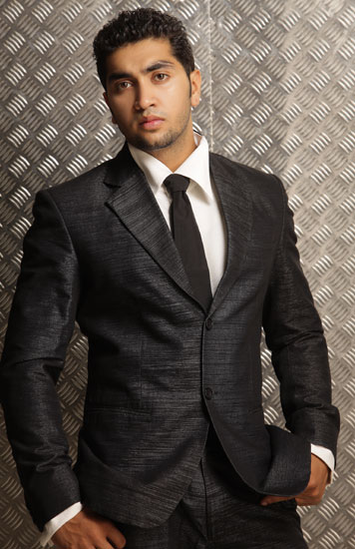
Hi, my name is Sean, and I would like to change some things in my life after I graduate. To do that, I thought about my plans and dreams I have for the future.
For example, I’m not going to eat junk food and I want to become a model.

Slide 3

I also want to study architecture, so I can become an architect. ☺ But I need to get ready for the university exam. Sometimes, it takes 3 times to finally enter the university.

Slide 4
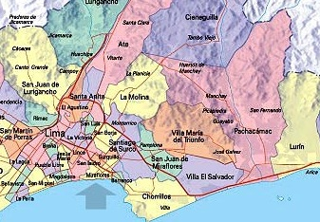


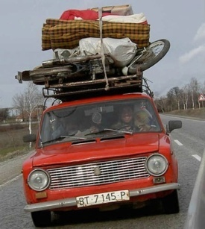
Now I am living in Surco, but I’d like to move to La Molina. Everyday there is a lot of traffic and I can´t take it anymore! It´s stressful, but I need to be calm, take it easy.

Slide 5


One of my goals is to apply for several jobs and get a good one.
… and eventually have little Sean

Slide 6
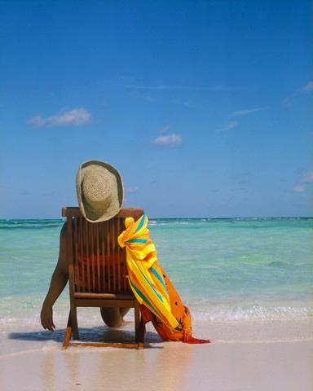


But those are my future plans and dreams. For now I’m going to take a break and take it easy. ☺
… I’m going to take a month off and go on vacation and travel to Bora Bora ☺

Slide 7
Well these are my plans and dreams
How about yours?
What are your plans and dreams?

Slide 8


